Slide 1
Name | James
Git Hash | c9175e76c1169eed9f00eb8c9a82329c865ecca4
Sprint number | Start date | end date | Work hard rating
4 | 30/5/2022 | 10/6/2022 | 3/5

Slide 2
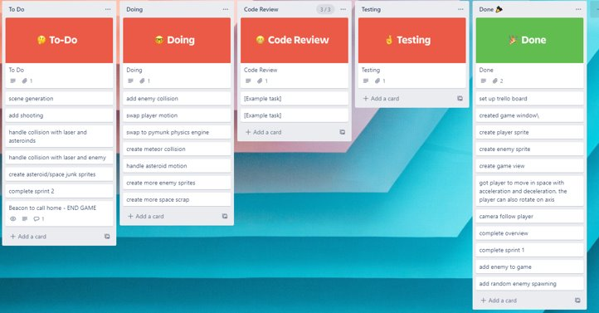
KANBAN board at the start of the sprint

Slide 3
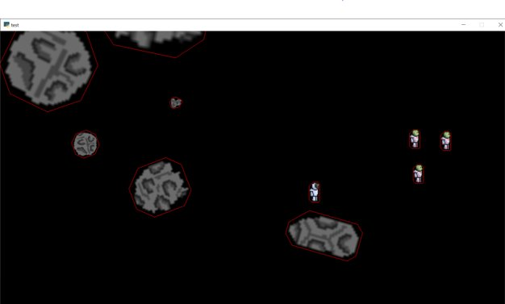
Screenshot of the game at the start of the sprint

Slide 4
Sprint Reflection and summary
I was able to get the properties of the asteroids working in the pymunk physics engine, so they move more freely and collide with each other and the player more realistically, the physics engine now works fully in the game excluding the unfinished enemies. This implementation of pymunk into the game took a very long time and was a hard area to put into the game correctly but now thats its mostly done it works well with the game and makes more realistic to use.
We also added a way to stop meteors spawning so much and stopped slowing down the game.

Slide 5
Briefly describe other team members contributions
Cam was able to get the enemy mechanics to work on multiple enemies at once and to get them moving around the screen seeking out the target whilst avoiding each other to prevent pile ups. This was large step in the progress of getting enemies fully working in the game. Overall he did a good job in this sprint

Slide 6
Major Changes and Achievements Described
Physics engine works in game except for unfinished enemy, without slowing the game down due to uncontrolled spawning of the enemy enabling the game to function as intended showing overall progress in its development.
Was able to get the mechanics of the enemy working with a pymunk physics engine to help with collisions in the test file with multiple enemies at once able to Safley peruse the target without piling up due them not avoiding each other nor having a physics engine to help with collisions. This shows that the enemy is nearly ready to be fully put into the game.

Slide 7
Brief Description of your testing
To test the physics engine i opened up the game and began to move the player in the direction of a meteor and collide with it, i found that the player bounced off of the meteor where as it didn't move much at all due to the drastic difference in mass showing that the physics was working properly, i also noticed when a asteroid collided with another that they bounced off each other in different directions and velocities dependant on their rotation directing mass and velocity, again showing the physics engine working. It passed testing.
We tested the enemies mechanics, we saw that when the target moved they tried to seek it out while avoiding each other or if not avoidable colliding and not piling up on each other, showing the mechanics were working they passed testing.

Slide 8
Link to testing results/tables

Slide 9
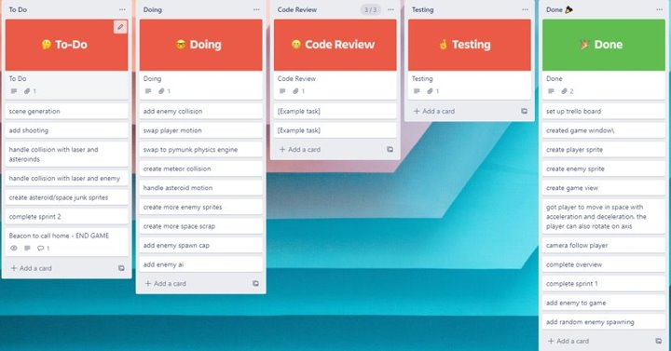
KANBAN board at the end of the sprint

Slide 10
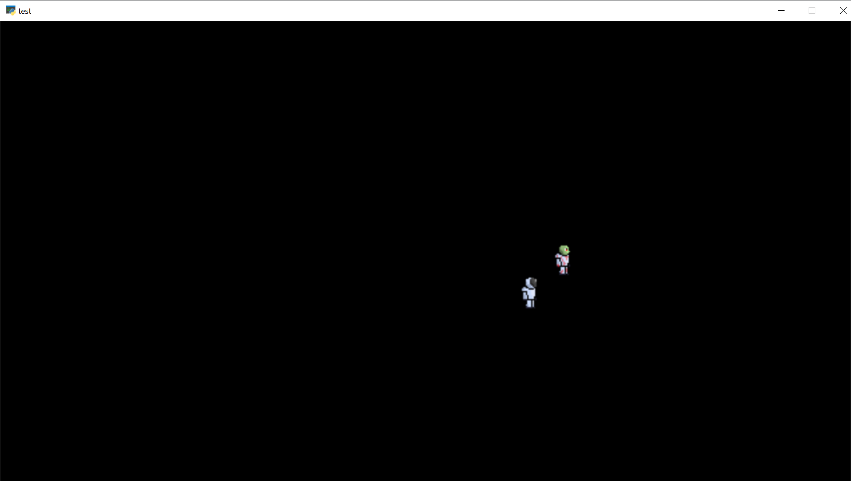
Screenshot of the game at the end of the sprint

Slide 11
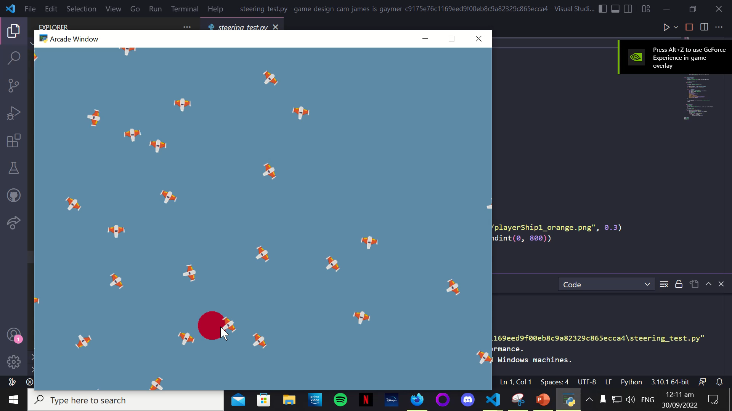
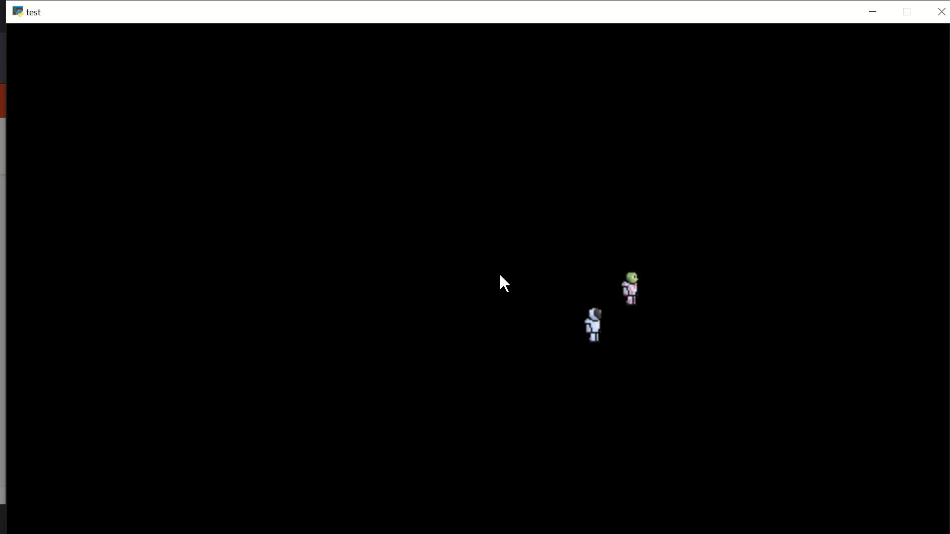
Video of the game at the end of the sprint

Slide 12
Notes for next time, future improvements
Although the physics engine is working well with the game it isnt fully done until the enemies' physics and mechanics are fully added, so for future improvement on the game i want to have fully added enemies into the game and the physics engine which will enable the game to take a huge step in its development. I also found again that my work speed is quite slow and i want to speed it up an get more things done in a sprint time frame to help the development of the game along but i do still need to plan for inconveniences such as me getting ill.
The next step in the game will be to have
Enemies working it the game with the physics engine
Design a sprite for the enemy
Get a bullet implemented into the game with its own sprite
Adding a start view to the game so it can have a start screen.

